Slide 1
Continue working on your Photography Genres presentation from last time if you have not finished
If finished, check your feedback
Completed Photography Genres Assignment:
Maja Drabek
Fatima Mahmood
Christopher Martin
Caitlin Morton
Siham Muhiaddin
Sadeen Qoraan
Haroon Rafiq
Eva Robertson
Salmah Sadat
Maisa Sattar
Jake Venters
Still to complete Genres Assignment:
Zainab Albaheli
Hollie Moffat
Abdullah Mirza
Abdul Rehman Muhammad
Musa Nadeem Faisal
Fahad Nasair
Rahib Rasool
Rajvir Singh
Alexander Stewart

Slide 2
Learning intentions and success criteria
I am learning…
I can…
About hardware used to capture and process still images
How to describe image hardware
Identify and describe the uses of different still image hardware devices
Create a presentation about different types of image hardware

Slide 3

Still Image Hardware
NPA Digital Media (Level 5)

Slide 4
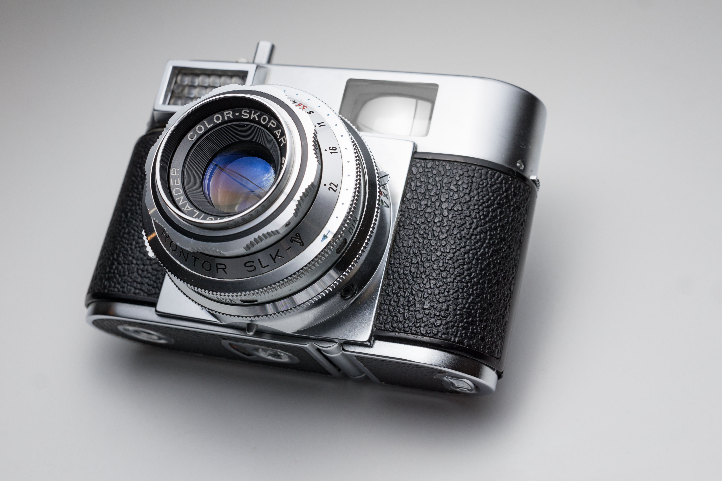
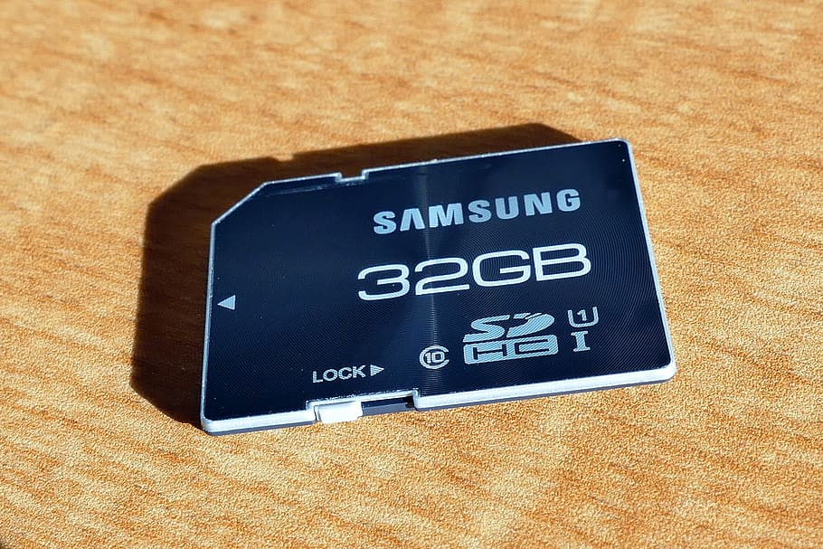
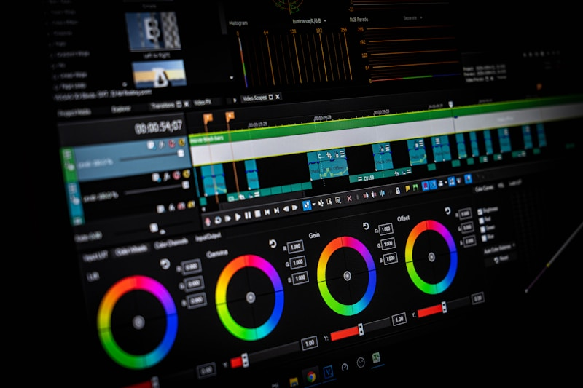
Introduction
There are many devices we can use to capture, store, and process still images.
Capture devices:
Used to take or digitise images
Storage devices:
Used to store image data
Processing devices:
Used to process or manipulate images

Slide 5
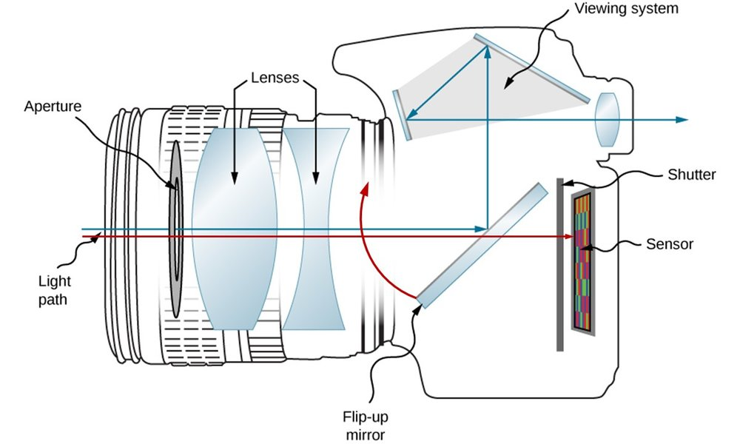
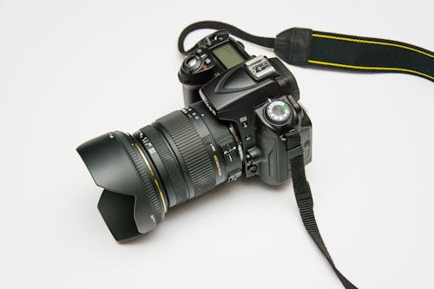
Capture – DSLR Camera
Stands for: Digital Single-Lens Reflex
Features: Interchangeable lenses, large sensors, optical viewfinder
Advantages: High image quality, good in low light, manual controls
Typical Use: Professional and enthusiast photography

Slide 6
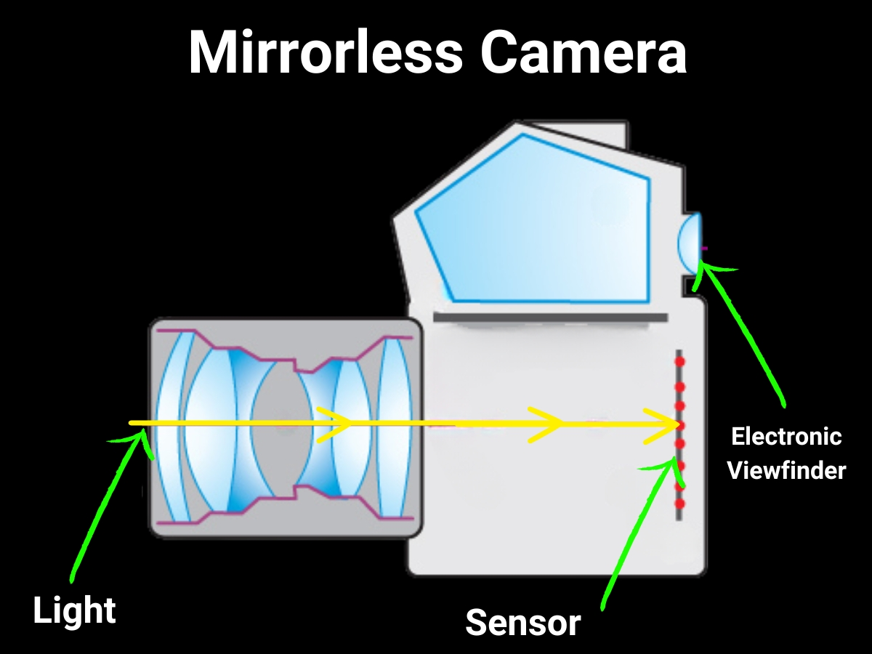
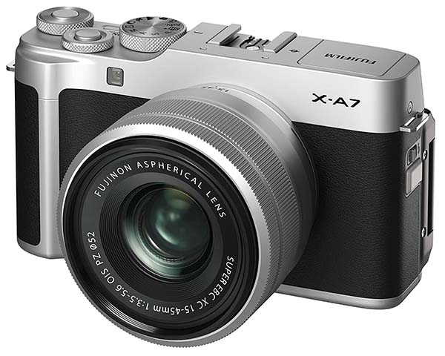
Capture – Mirrorless Camera
Key Difference: No mirror → smaller, lighter than DSLRs
Features: Interchangeable lenses, electronic viewfinder/screen
Advantages: Compact, fast shooting, often better video
Typical Use: Professionals and hobbyists wanting portability

Slide 7
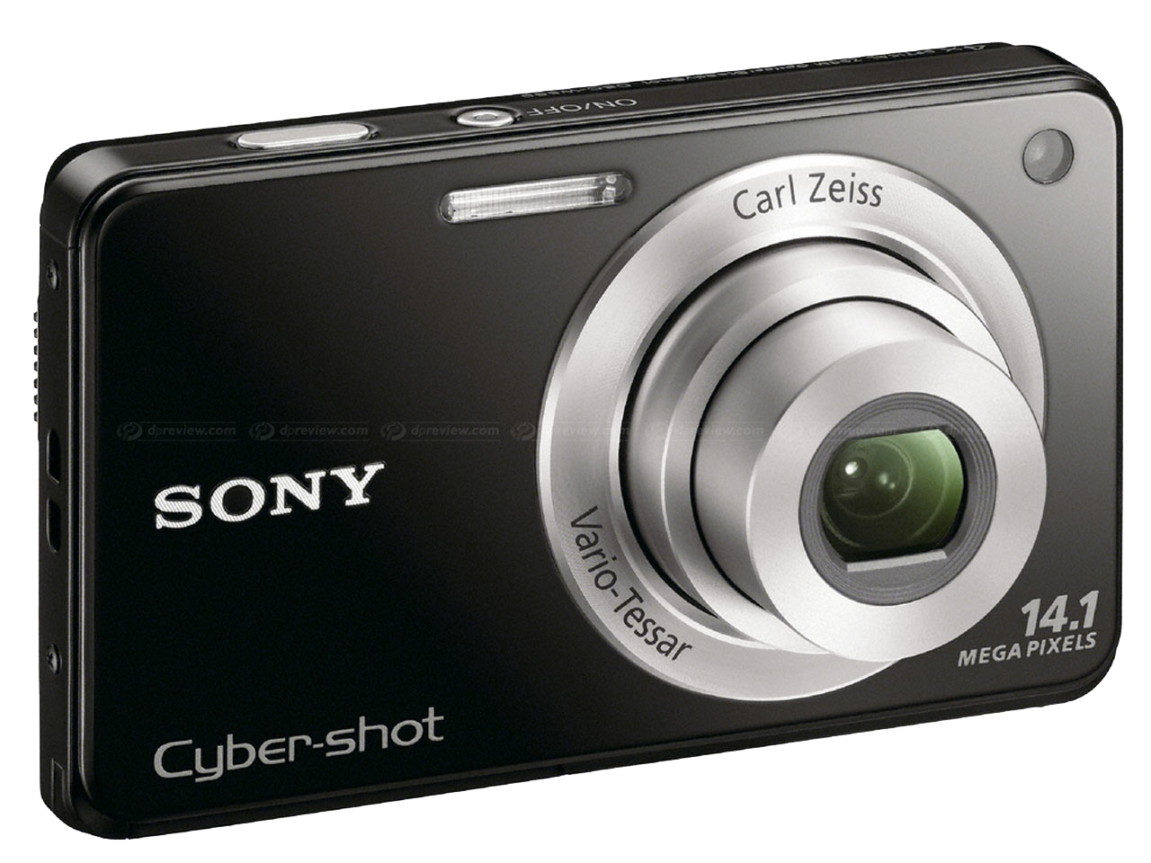
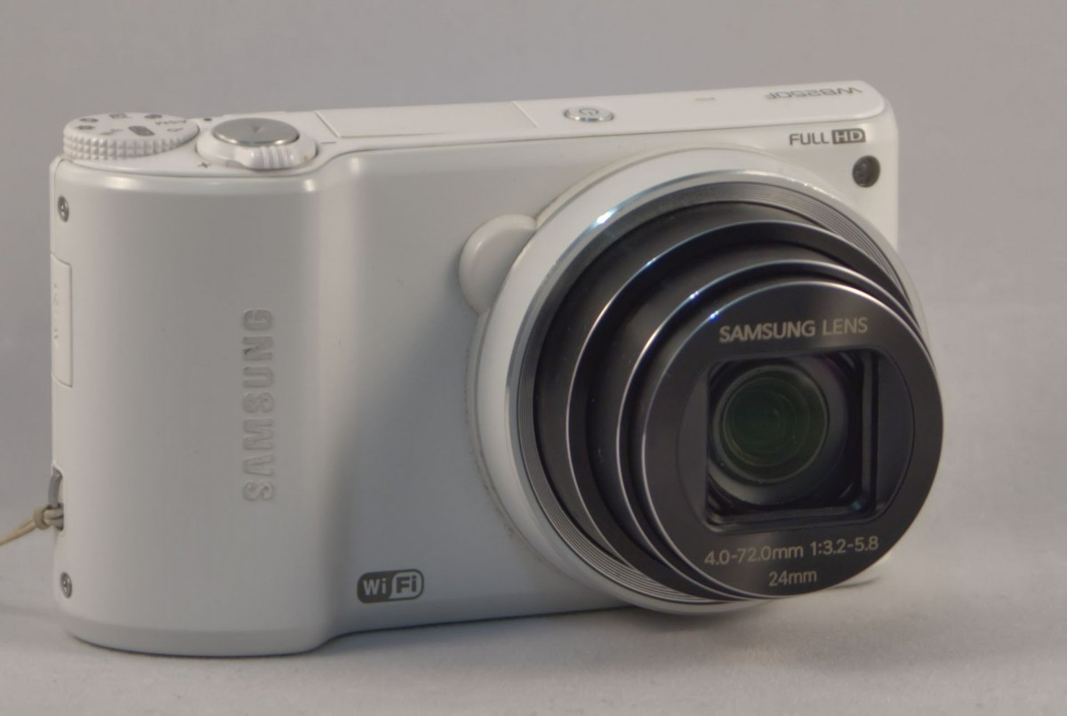
Capture – Compact Camera
Also Called: Point-and-shoot, digicam
Features: Fixed lens, automatic settings
Advantages: Small, easy to use, affordable
Typical Use: Casual photography, travel

Slide 8
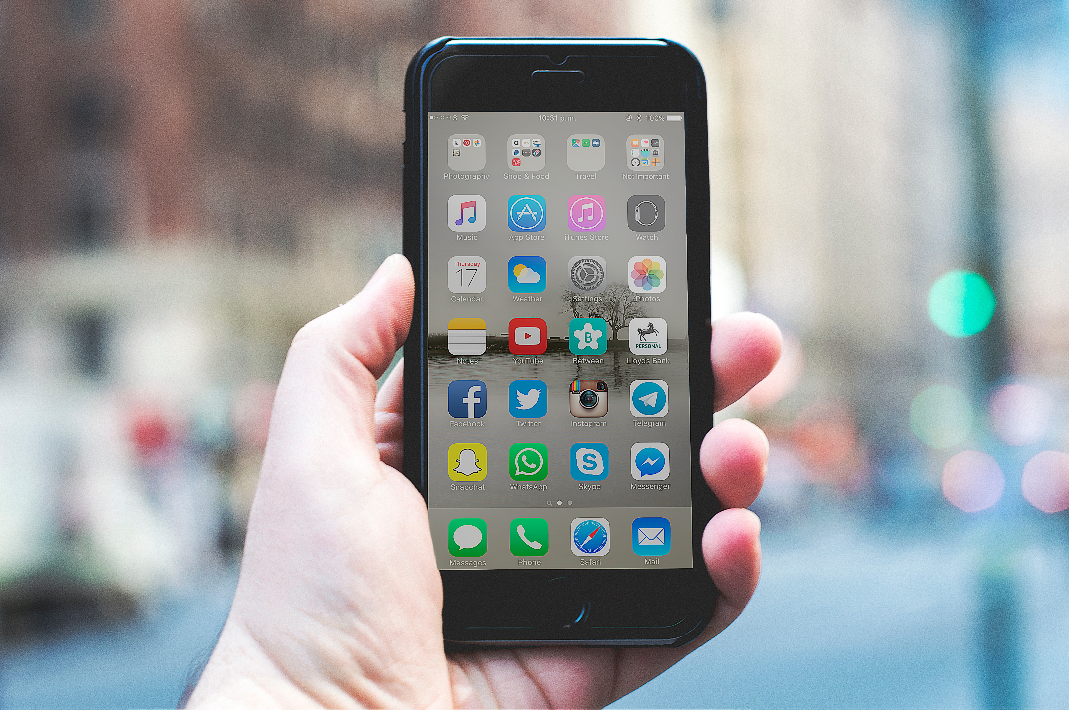
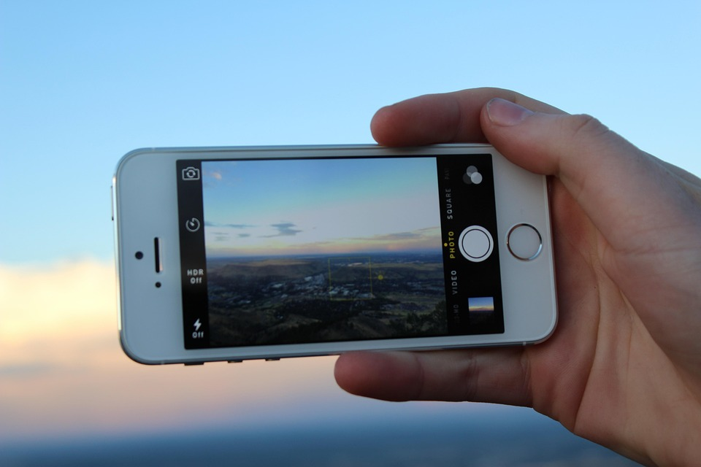
Capture – Smartphone Camera
Features: Built-in lens and sensor, computational photography (AI, HDR, filters)
Advantages: Always available, easy sharing, improving quality
Typical Use: Everyday photography, social media

Slide 9
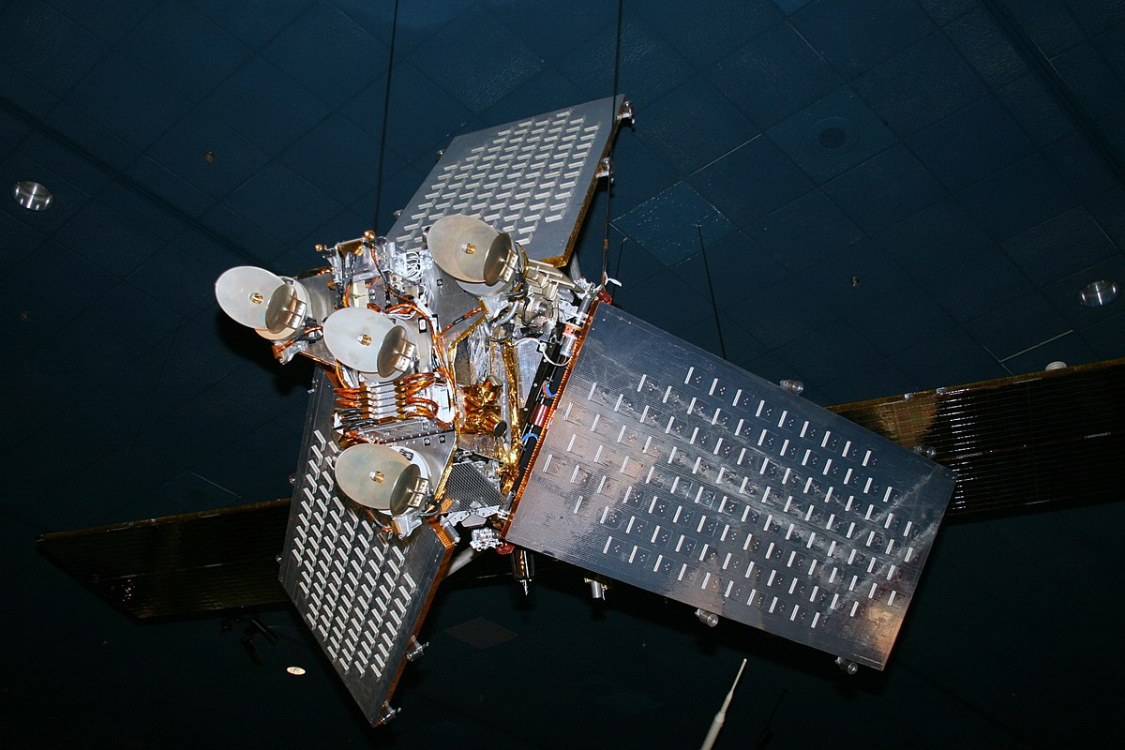
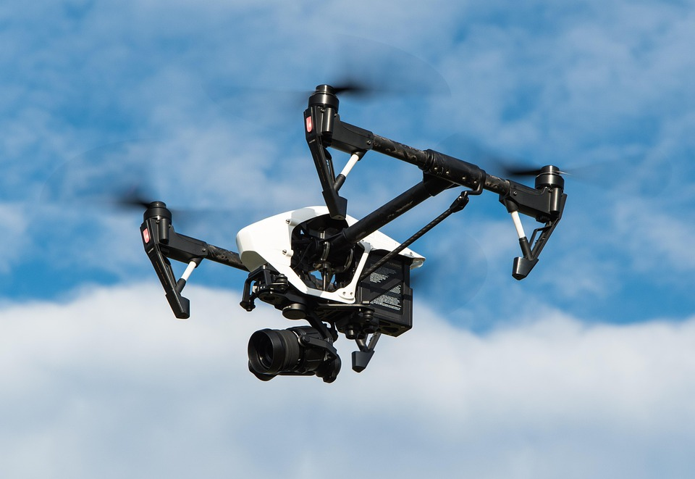
Capture – Satellite/Drone
Satellite: Captures large-scale, high-resolution Earth images
Drone: Aerial photos/videos at different altitudes and angles
Advantages: Unique perspectives, remote operation
Typical Use: Mapping, surveillance, journalism, landscape photography

Slide 10
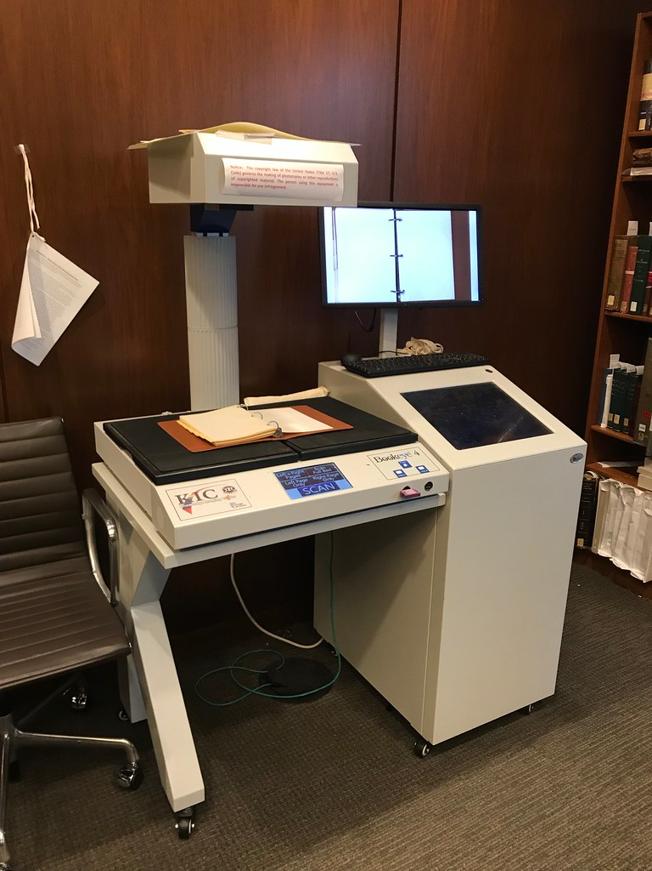
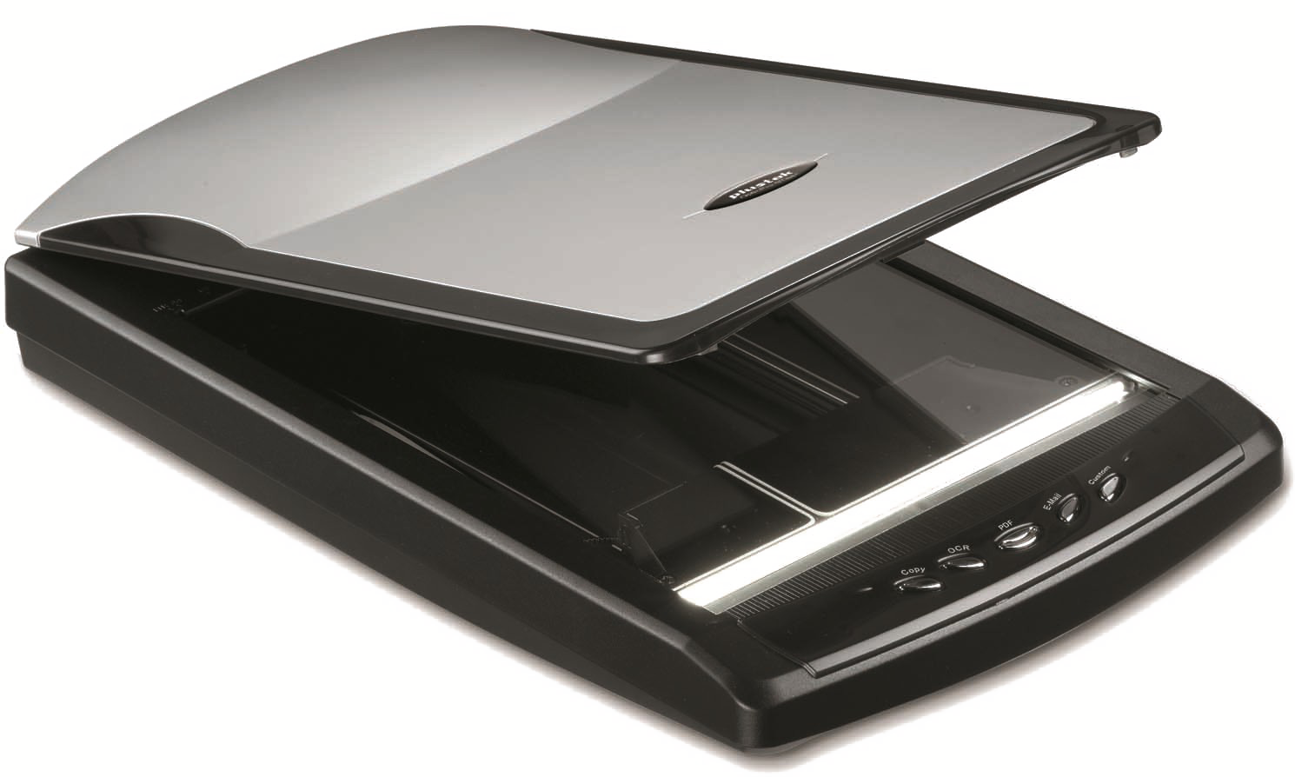
Capture – Scanner
Function: Converts physical images/documents into digital files
Types: Flatbed, sheet-fed, film/slide
Advantages: Preserves old photos, enables editing
Typical Use: Archiving, document management

Slide 11
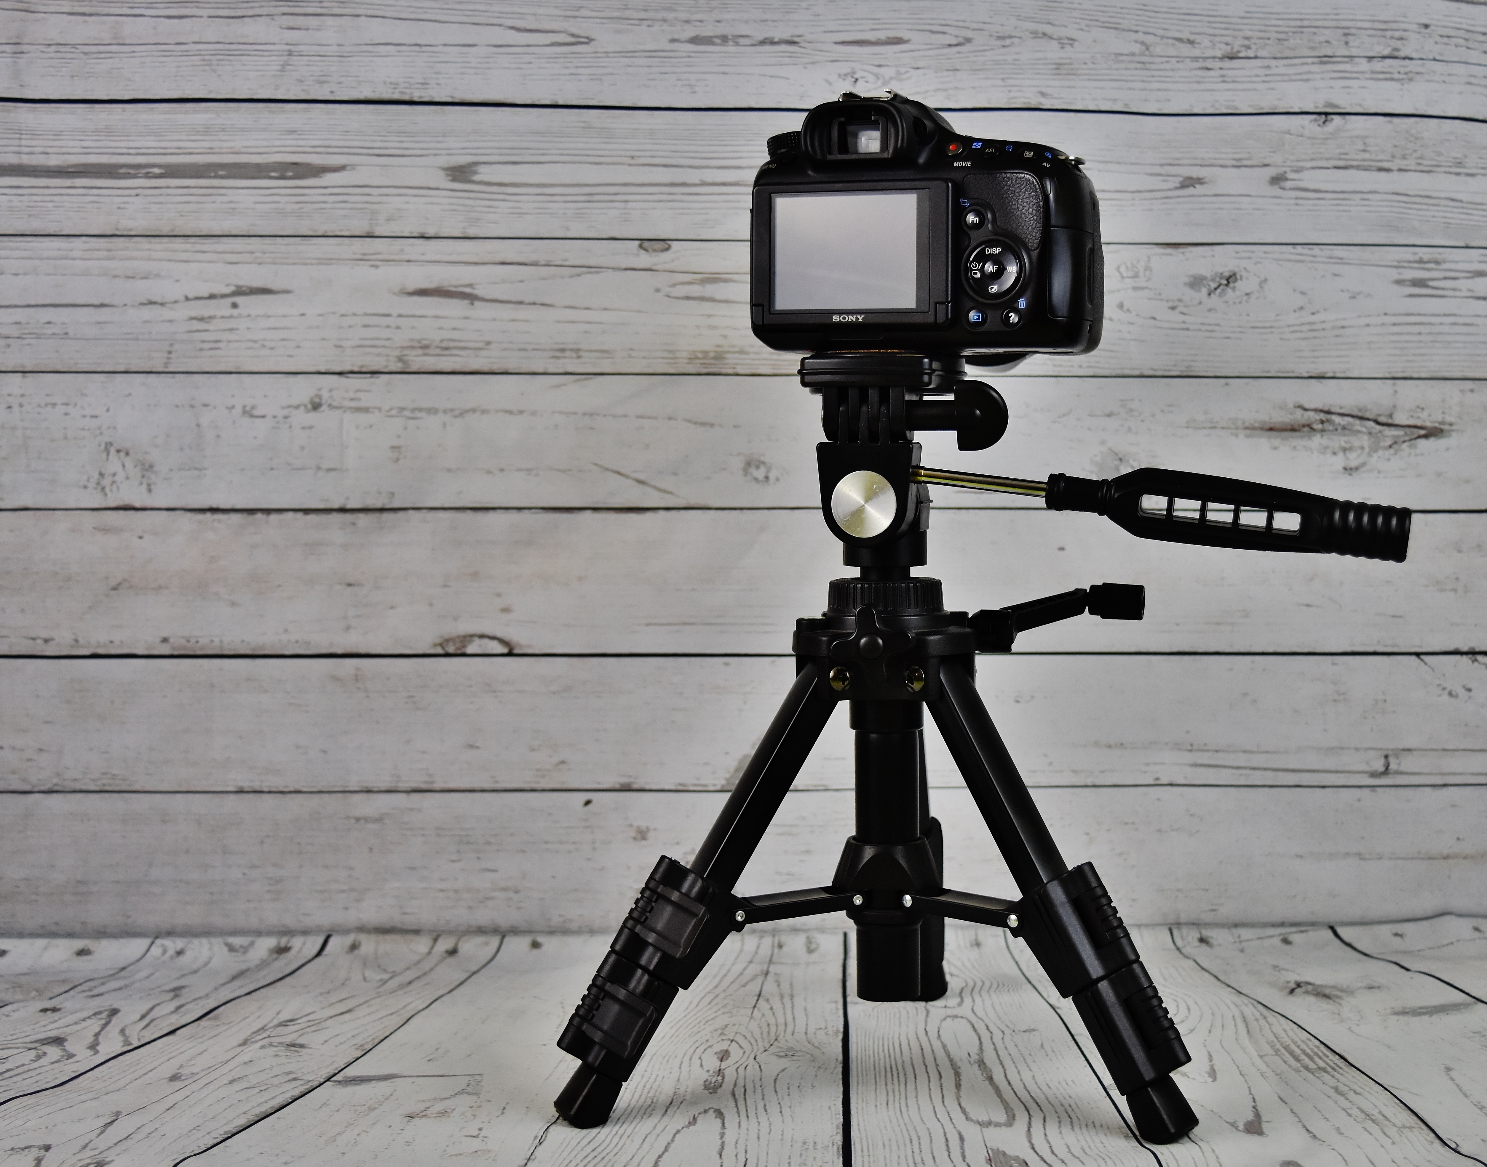
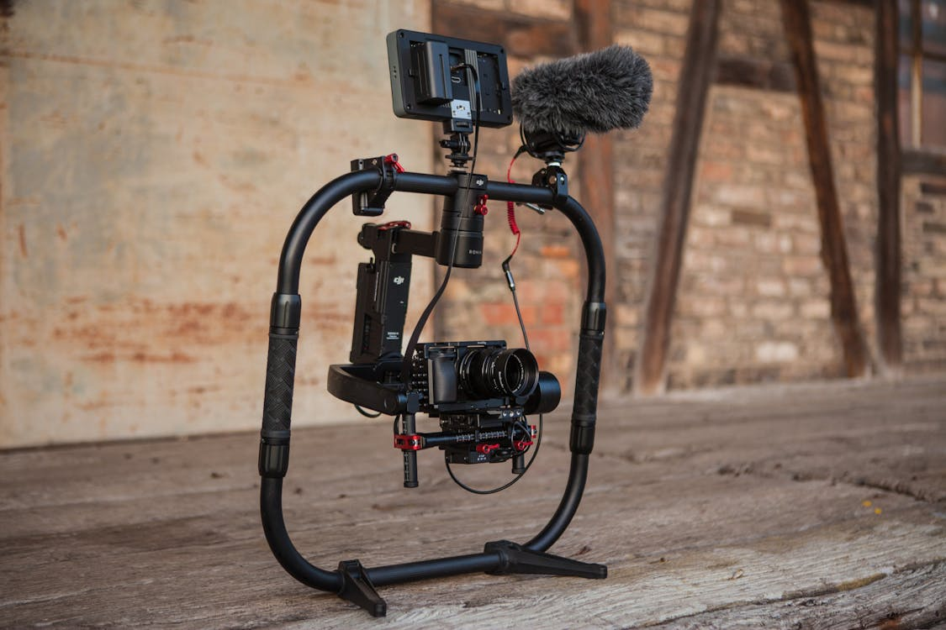
Capture – Tripod/Stand
Function: Stabilizes the camera
Advantages: Reduces camera shake, enables long exposures, consistent framing
Typical Use: Landscape, night photography, studio shoots

Slide 12
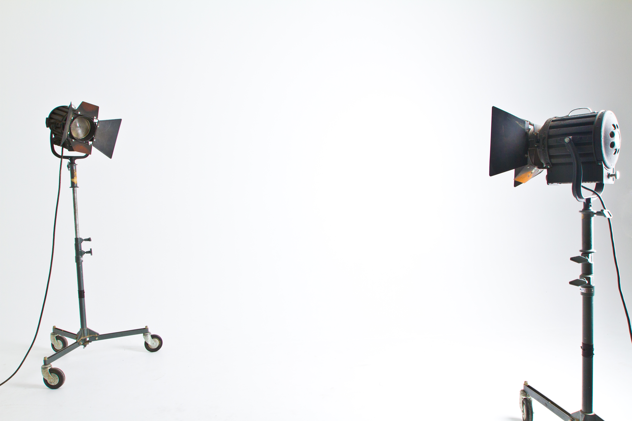
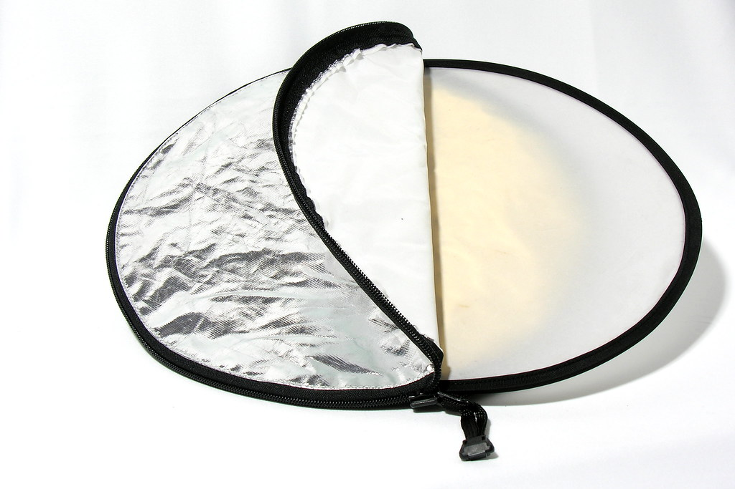
Capture – Lighting
Examples: Studio lights, LED panels, ring lights, reflectors
Advantages: Controls shadows, improves clarity and colour
Typical Use: Portraits, product photography, professional shoots

Slide 13
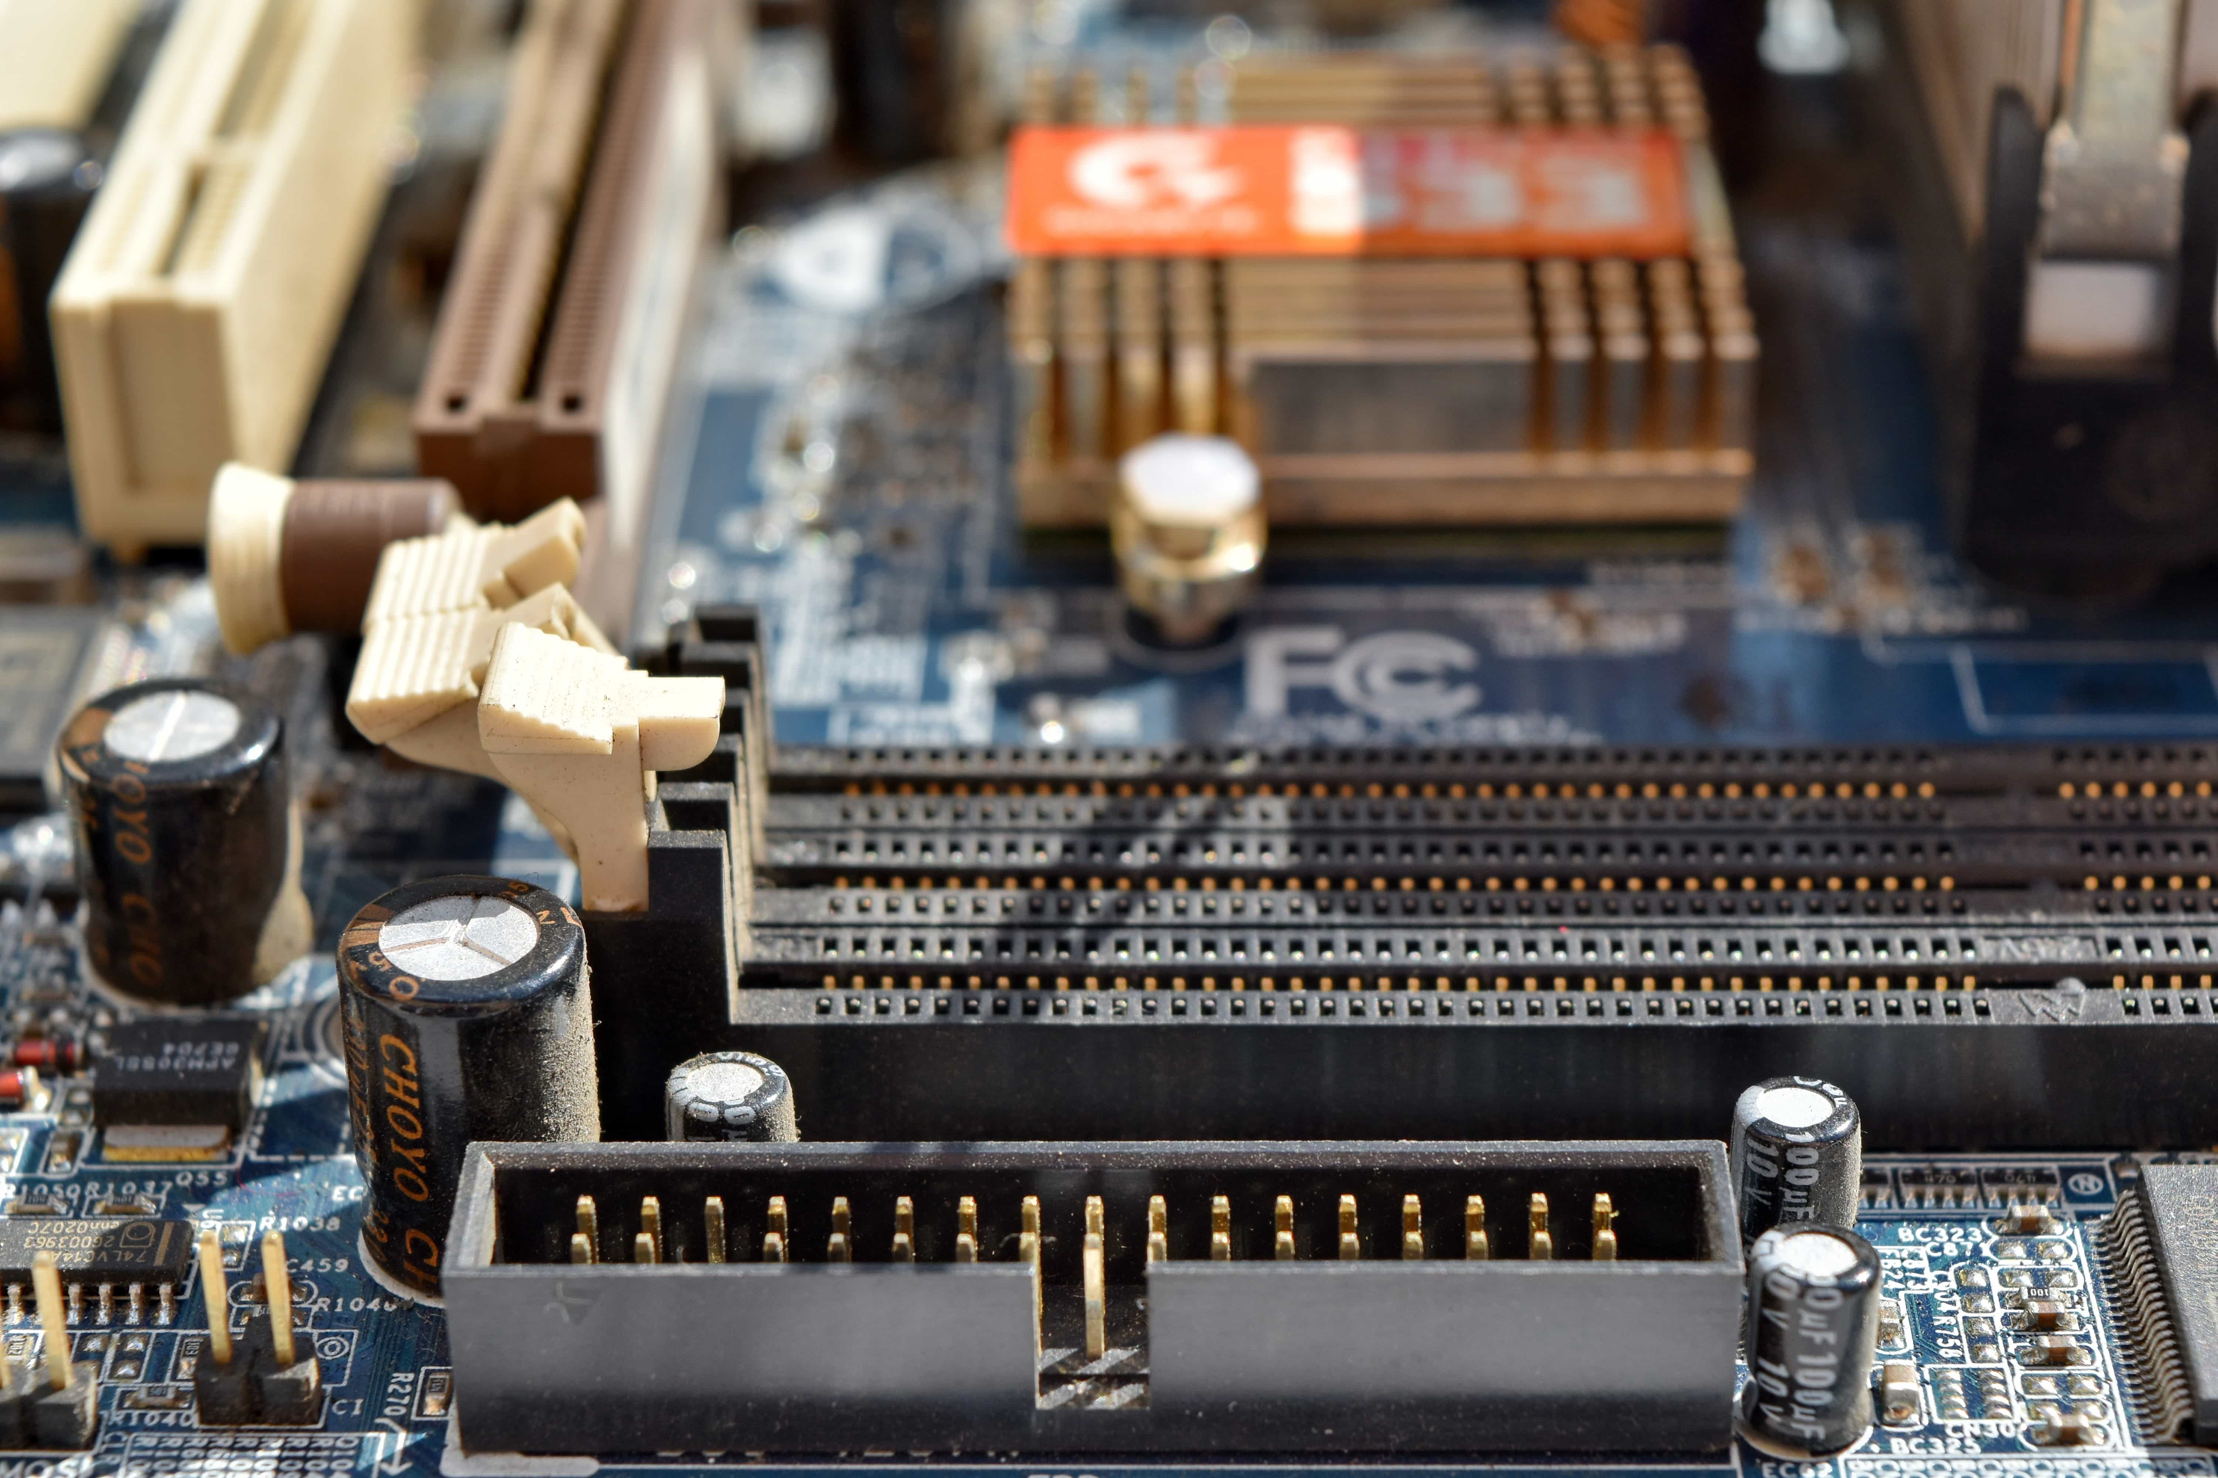
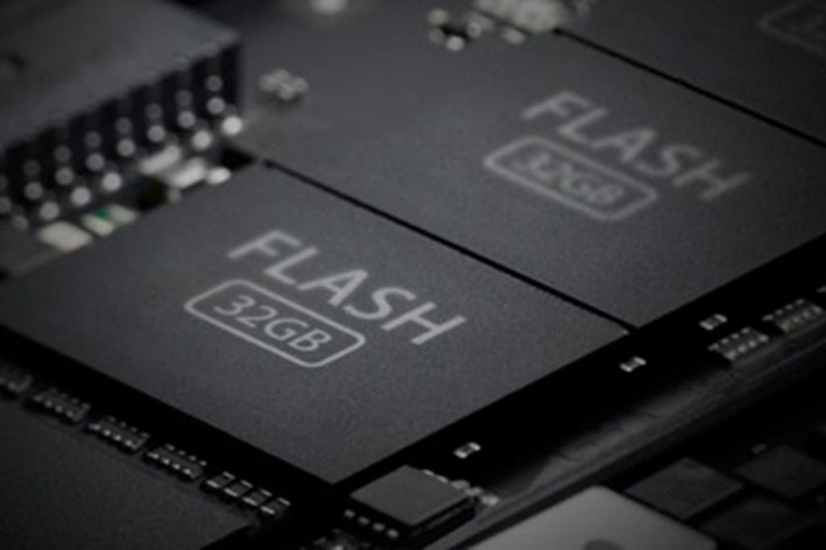
Storage – Internal Device Storage
Function: Built-in storage for cameras, drones, phones
Advantages: On the device itself, fast transfer speed
Disadvantages: Cannot be separated from the capture device
Typical Use: Temporarily store images on the device so they can be transferred to permanent storage after a shoot

Slide 14
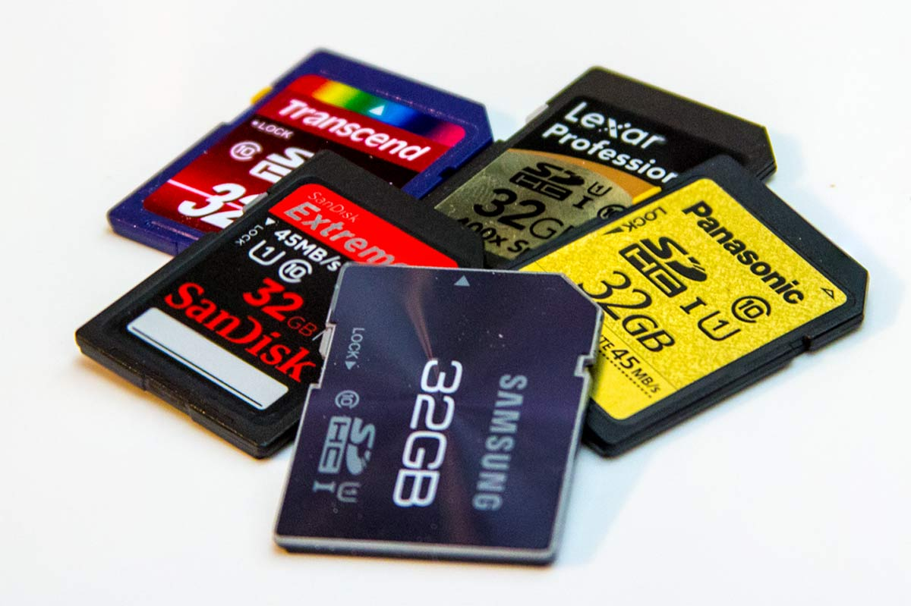
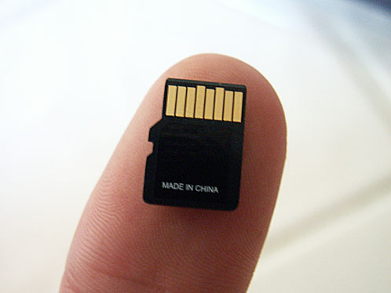
Storage – SD/Micro SD cards
Function: Removable storage for cameras, drones, phones
Advantages: Portable, inexpensive, reusable
Capacity: Ranges from MBs to several TBs

Slide 15
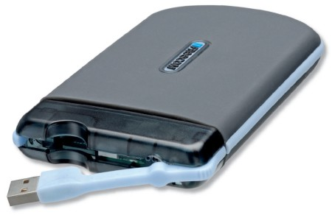
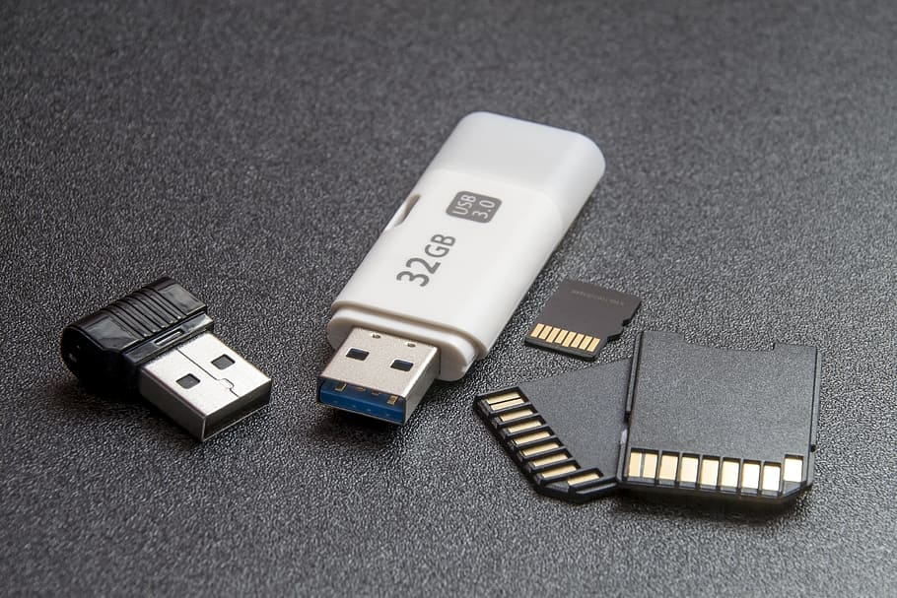
Storage – Portable Drive
Types: Hard-Drive (HDD) or Solid-State (SSD)
Function: External storage connected via USB/Thunderbolt
Advantages: Large capacity, useful for backups
SSD vs HDD: SSD faster & durable, HDD cheaper per GB

Slide 16
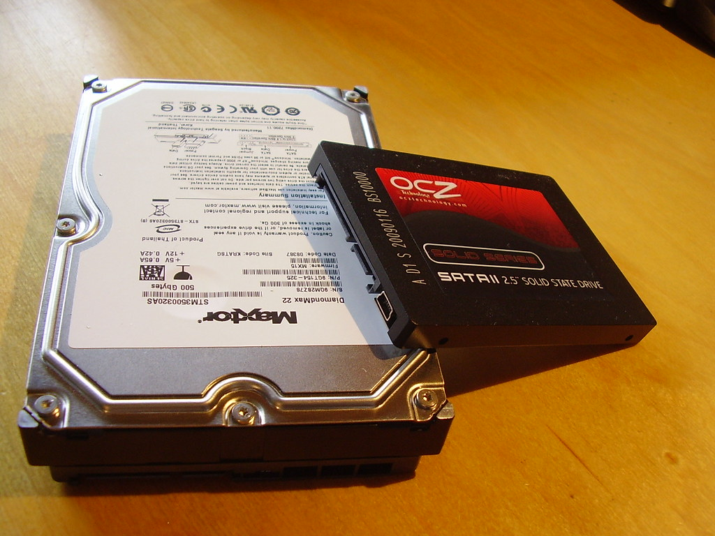
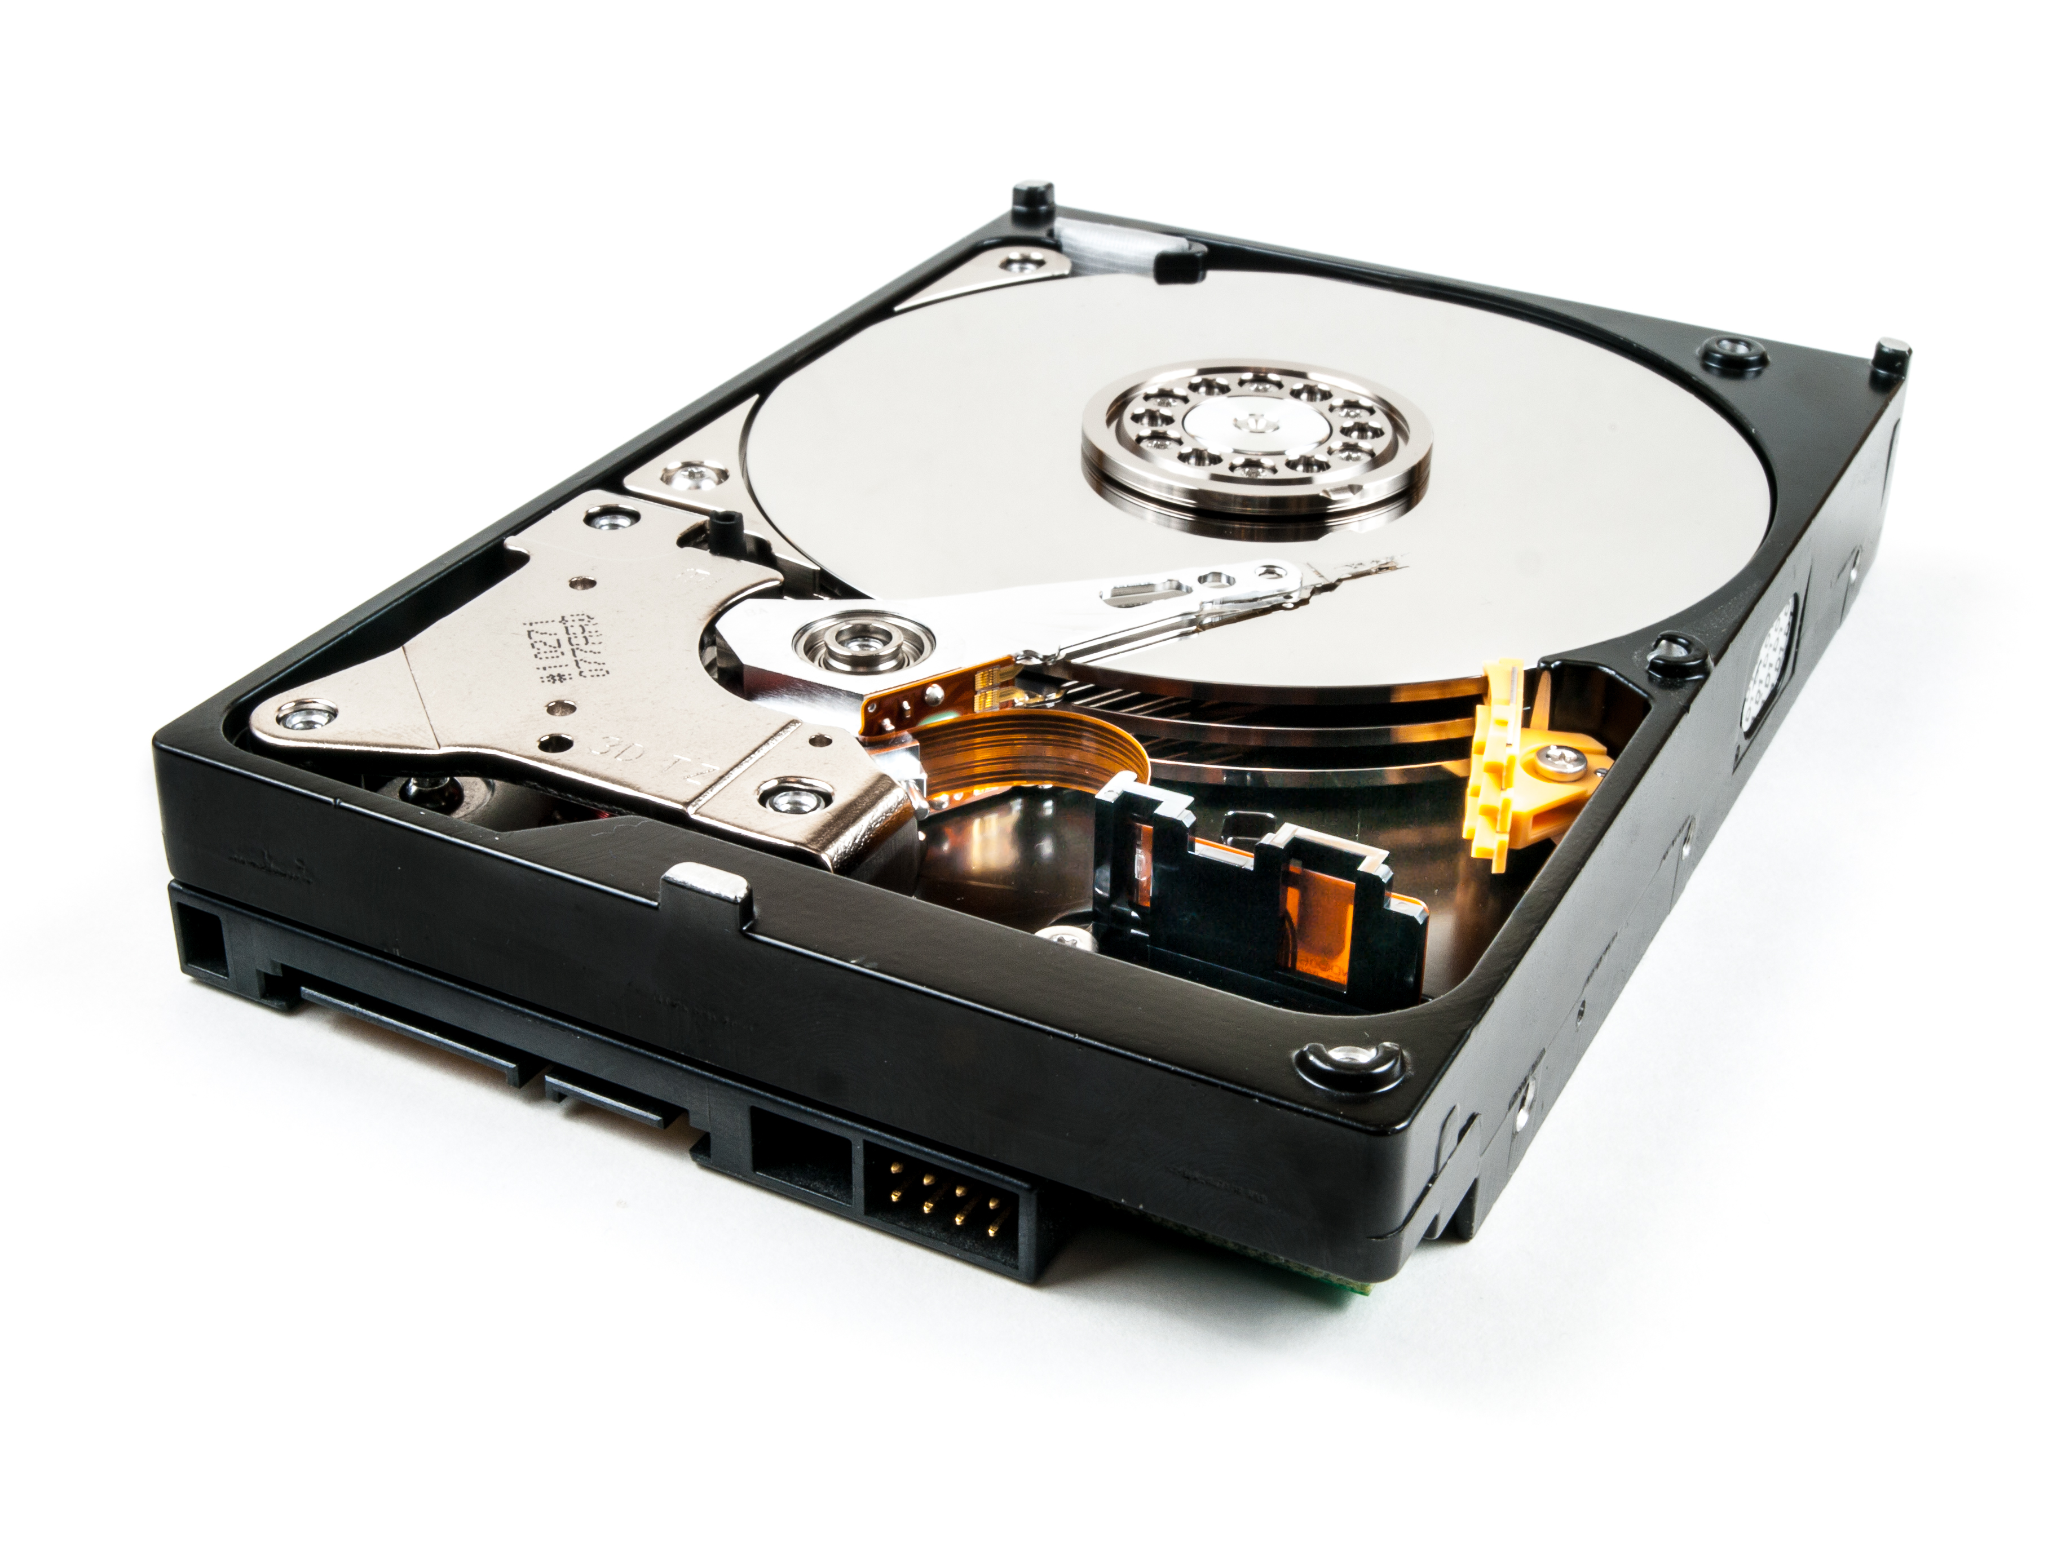
Storage – Computer Storage
Function: Storage device inside a computer
Advantages: Large, permanent storage, quick access/editing
Typical Use: Editing and managing photo libraries

Slide 17


Storage – Cloud Storage
Examples: Google Photos, iCloud, OneDrive
Advantages: Access anywhere, backup protection, sharing
Considerations: Requires internet, may have subscription fees

Slide 18
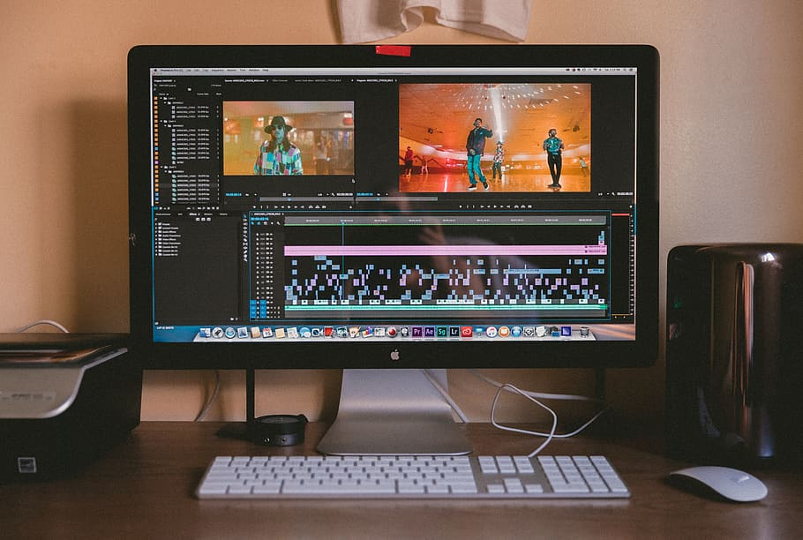
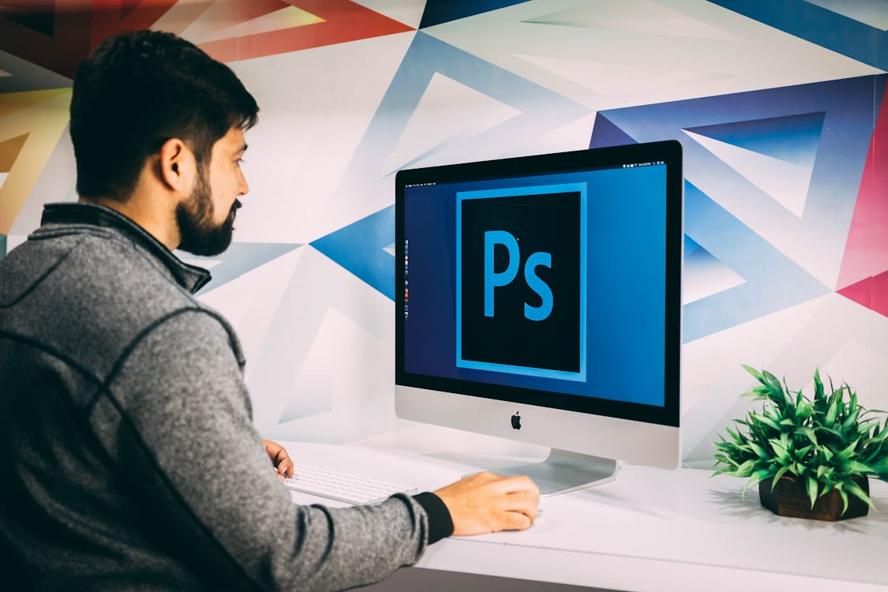
Processing – PC
Features: More powerful hardware for image editing
Advantages: Runs advanced editing software (Photoshop, Lightroom)
Typical Use: Professional photo editing and storage

Slide 19
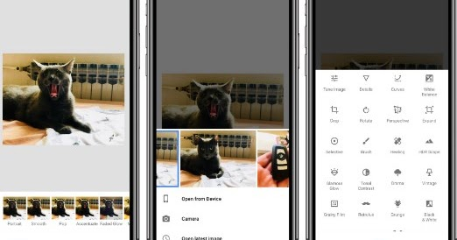
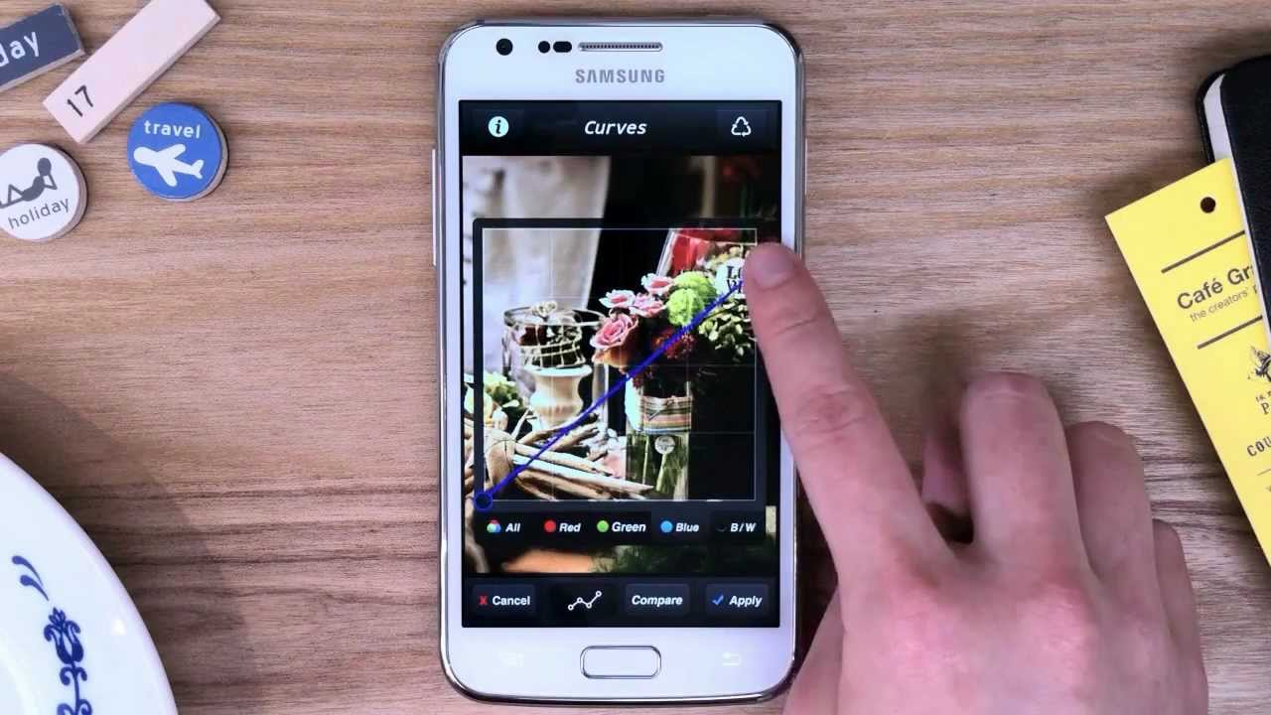
Processing – Smartphone/Tablet
Features: Mobile editing apps, touch interface, portability
Advantages: Quick edits, share instantly
Typical Use: Casual editing, social media content creation

Slide 20
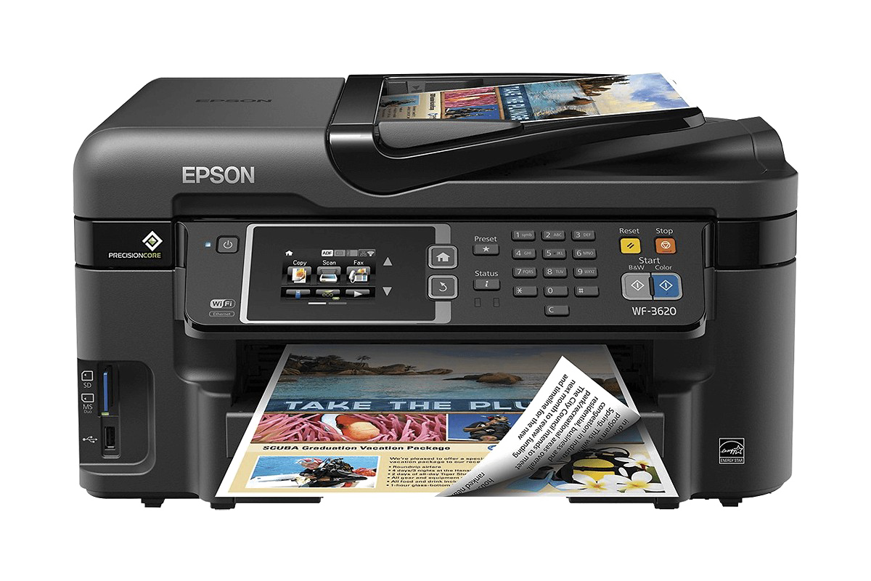
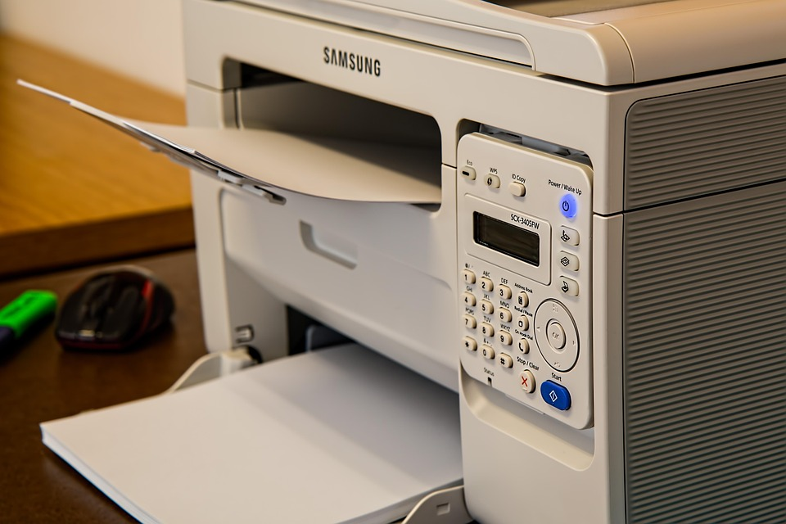
Processing – Printer
Types: Inkjet (better for photos), Laser (faster, office use)
Advantages: Produces physical copies of digital images
Typical Use: Photo prints, albums, exhibitions

Slide 21
Learning intentions and success criteria
I am learning…
I can…
About hardware used to capture and process still images
How to describe image hardware
Identify and describe the uses of different still image hardware devices
Create a presentation about different types of image hardware

